Slide 1

RecommendatIon System for SpotIfy
Ersin Onur Yukay
Muhammet Çınar

Slide 2

What ıs spotıfy ?
Started at 2006 in Sweden.
Worldwide audio streaming and media services provider.
As of March 2023, total of 515 million users (Appr. 60 % premium customers).

Slide 3
Project scenerıo
Using a publicly available dataset which was orginally scraped from Spotify’s API, a clustering operation will be done in terms of technical properties of songs.
For clustering, KMeans algorithm will be used and if applicable, Principal Component Analysis will be used to reduce the number of features to make a better visualization and easier analysis.
Final recommendation system is supposed to recommend songs with closest technical features from the same cluster.

Slide 4
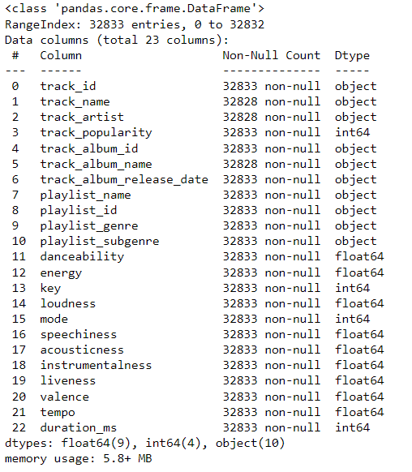
Quıck glance on the dataset
There are 13 numeric columns which will be used in the model.
Since this model clusters songs according to their technical properties, non-numeric columns such as genre won’t be used in the model.

Slide 5
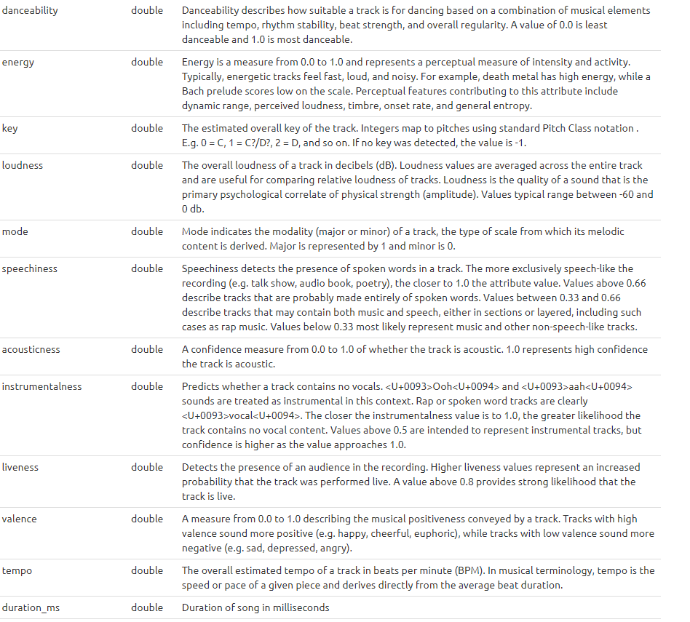
Technıcal features
The table in the right shows what these technical features stands for.

Slide 6
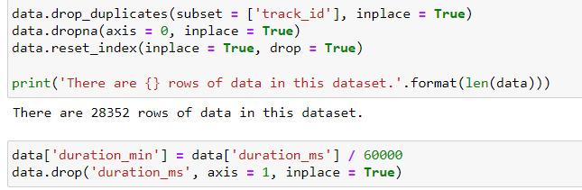
Data preprocessıng
Some of the tracks are from different people’s playlists. But they are still the same tracks with same technical properties.

Slide 7
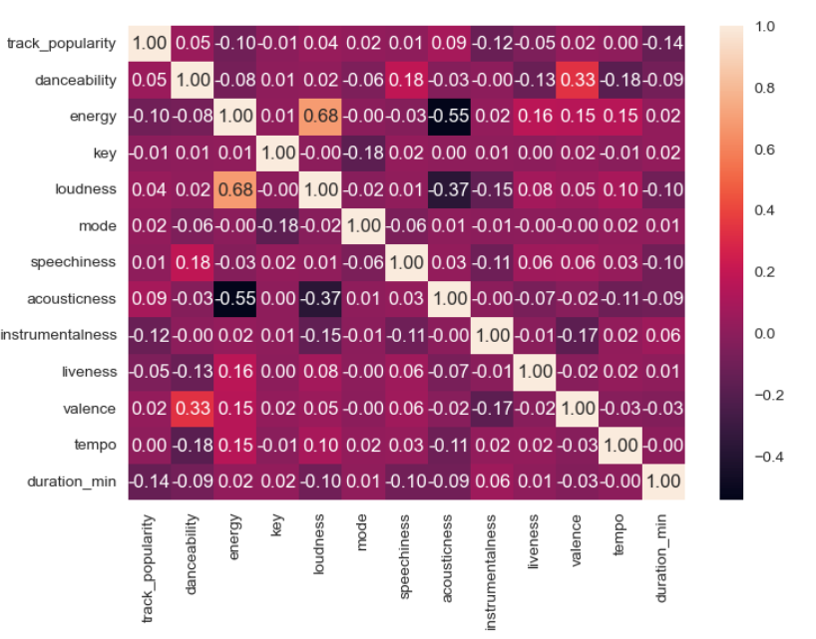
Data preprocessıng
Multicollinearity is checked.
No unreasonably high values appeared in the correlation table.

Slide 8
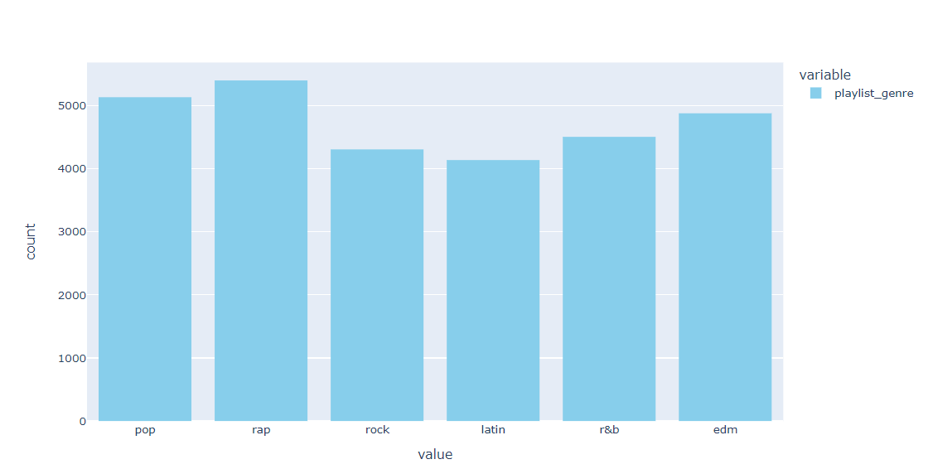
Exploratory data analysıs

Slide 9
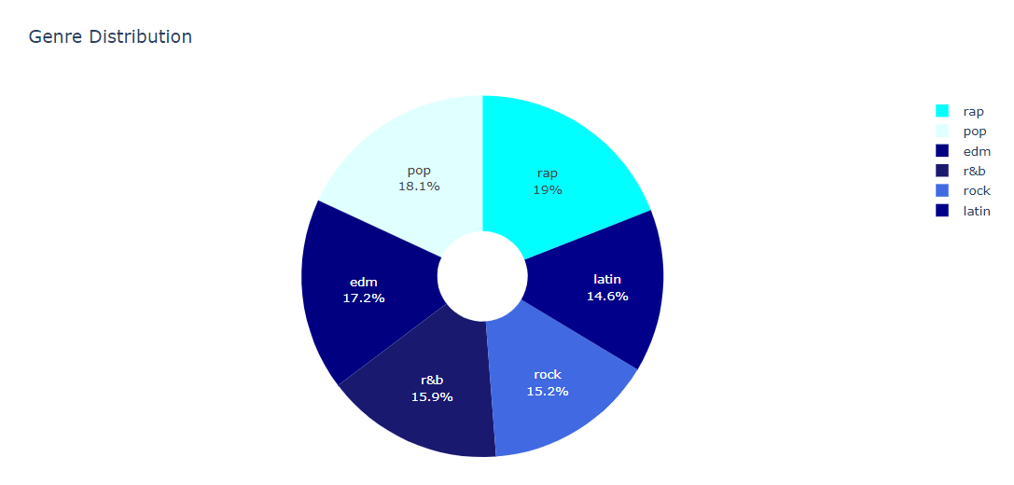
Exploratory data analysıs

Slide 10
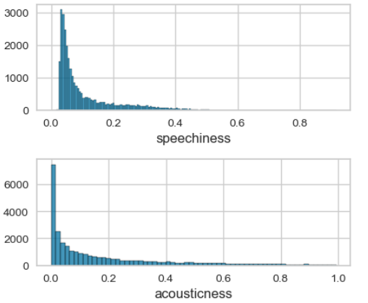
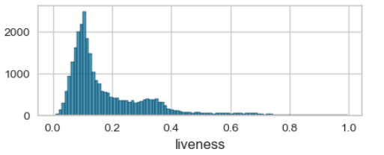
Exploratory data analysıs
Some of the features are far away from Normal Distribution.
Scaling should be done.

Slide 11
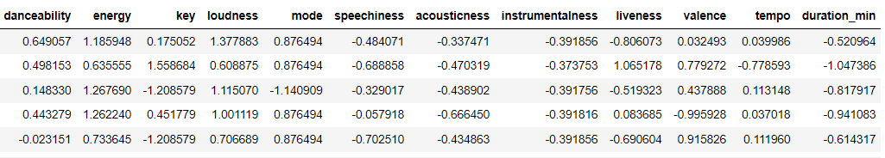
Feature scalıng and normalızatıon
Using StandardScaler(), features are scaled.

Slide 12
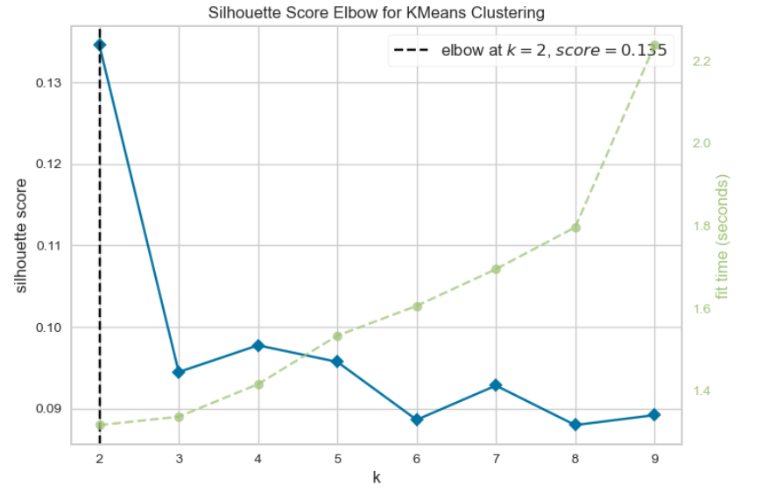
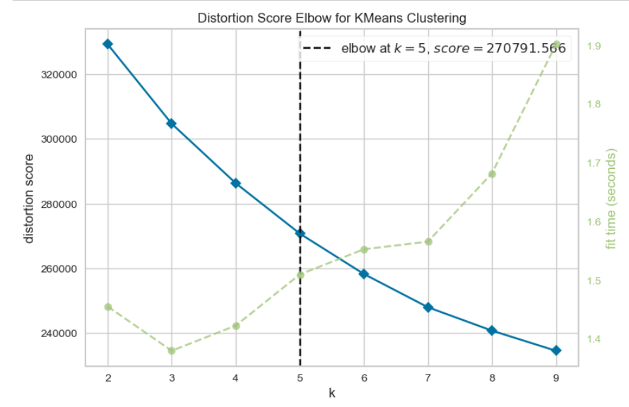
Kmeans clusterıng
Looking at both tables, k = 5 is selected.

Slide 13

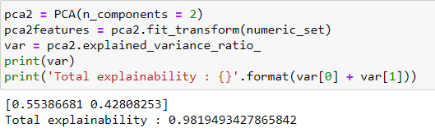
Dımensıon reductıon
Using PCA with 2 components, dimension reduction is done.
As it can be seen from the figure, PCA with 2 features, explains more than 98% of our model.

Slide 14
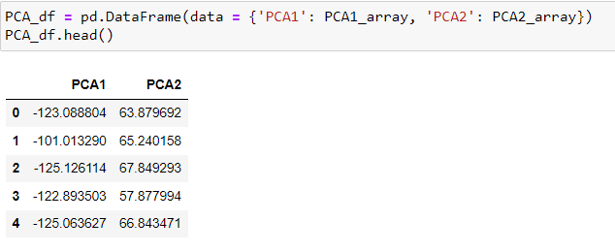
Dımensıon reductıon
Using the 13 technical features and 2 PCA equations which contains 13 unknowns both, for every single track we created a 2 feature dataframe as shown here.

Slide 15
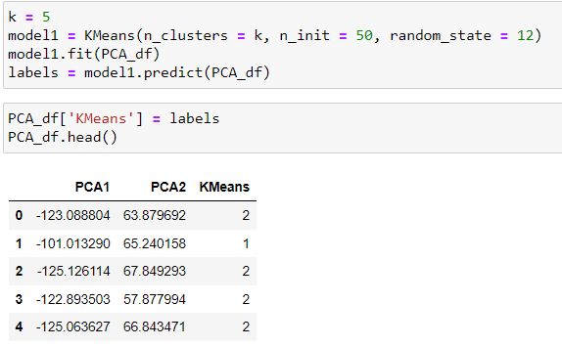
Dımensıon reductıon
The order of indexes are samw with the original Spotify dataset. In other words the first index in the PCA DataFrame is representing the first index(first song) in the original dataset.
This way the data is basically transformed into a 2D space from a 13D space.

Slide 16
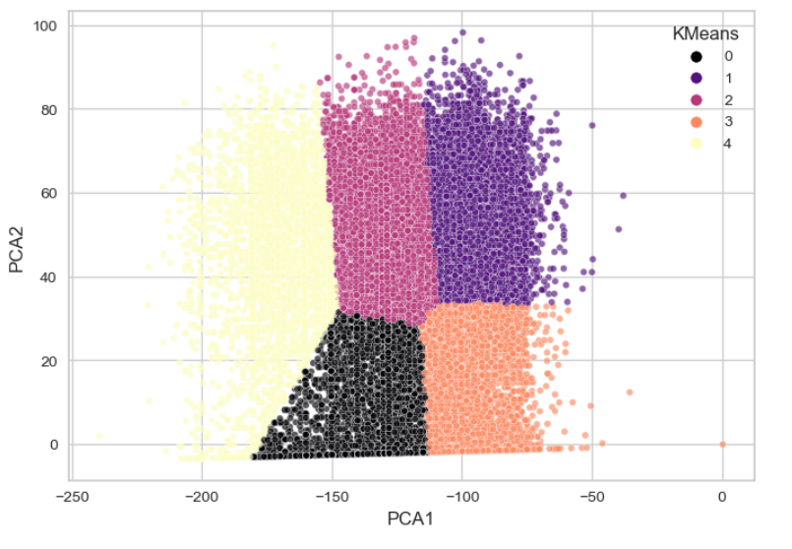
Clusterıng

Slide 17
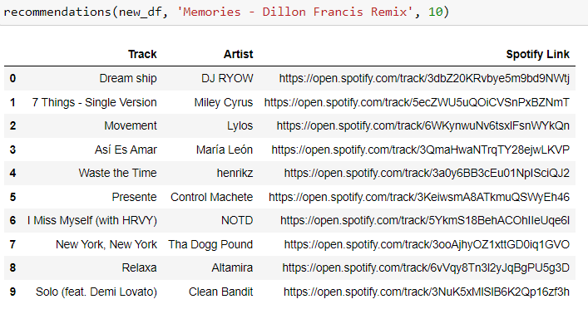
Recommendatıon system
Recommendation system returns the most similar ‘n’ number of songs with their artists and the relevant Spotify link.

